Slide 1
Lakehouse Monitoring
Data Quality with Intelligence

Slide 2
Why do I need to monitor data quality?
Notes:
Without a data quality solution, we often common problems among data engineering and ML teams. Do any of these situations sound familiar to you?

Slide 3



Challenges in adopting Data Quality tools
Hard to scale
Noisy alerts
High friction
Notes:
High friction – It’s high effort to integrate separate tools across data engineers, analysts, and ML, especially when tools live apart from the data platform
Hard to scale – It’s hard to scale a variety of frameworks and have teams learn multiple solutions
Noisy alerts – It’s challenging to write rules with complex patterns like seasonality or changing ranges. This often leads to disruptive alerts that are hard to filter.
These are all challenges that we’ve thought a lot about and we believe that Lakehouse Monitoring is the solution by allowing you to address any data quality concern directly in Databricks, directly with your data platform. Let’s explore how:

Slide 4
What is Lakehouse Monitoring?

Slide 5
Teams want to monitor many assets.
Bronze, Silver, Gold
Time Series
MVs, STs
Features
Model
Model
Inference Table

Slide 6
Data and AI assets come from many frameworks
dbt
DLT
Workflows
DB Serving
3rd-party Serving
Bronze, Silver, Gold
Time Series
MVs, STs
Features
Model
Model
Model
Inference Table

Slide 7

Lakehouse Monitoring
Profile, Diagnose, and Enforce Quality for any table in the UC.
dbt
DLT
Workflows
DB Serving
3rd-party Serving
Dashboard
Bronze, Silver, Gold
Time series
MVs, STs
Features
Model
monitor
monitor
monitor
monitor
Inference Table
Profiling Data
Table
Expectations and Alerts
monitor
Data Drift
Table

Slide 8


What is Lakehouse Monitoring
Data
Automated profiling of any Delta table
Lakehouse Monitoring
Quality across your entire data + AI estate
AI
Model drift and performance
Unity Catalog
Metadata
Governance
Serverless
Notes:
Unified approach to monitoring data and AI: Profile, Diagnose, and Enforce quality across any table
Built into Unity Catalog: Get data quality alongside governance
Fully Serverless: Never worry about infrastructure or tuning compute configuration

Slide 9
Announcing
Lakehouse Monitoring is Generally Available
Author Name Date

Slide 10

Deep dive demo
DAIS Lakehouse Monitoring Talk with the Product team
Notes:
Detect common issues like duplicates, incompleteness, or drift before they trickle downstream
Enforce data quality checks directly in workflows
Get alerted, Fail a job or Drop a record upon violation

Slide 11
Why Lakehouse Monitoring?
=
High friction
Notes:
From Friction → Simplicity

Slide 12

Why Lakehouse Monitoring?
=
Simple
High friction
Notes:
Simple – Automated profiling out of the box

Slide 13
Why Lakehouse Monitoring?
=
=
Simple
High friction
Hard to scale
Notes:
Instead of being hard to scale, LHM is scalable

Slide 14

Why Lakehouse Monitoring?
=
=
Simple
Scalable
High friction
Hard to scale
Notes:
Scalable – Unified solution for data and AI, works on any table in Unity Catalog

Slide 15
Why Lakehouse Monitoring?
=
=
=
Simple
Scalable
High friction
Hard to scale
Noisy alerts
Notes:
Instead of getting bombarded with noisy alerts, LHM is intelligent

Slide 16

Why Lakehouse Monitoring?
=
=
=
Simple
Scalable
Intelligent
High friction
Hard to scale
Noisy alerts
Notes:
Intelligent – Forecasts quality thresholds and automates expectations, reducing noise.

Slide 17

“Lakehouse Monitoring has been a game changer. It helps us solve the issue of data quality directly in the platform... it's like the heartbeat of the system. Our data scientists are excited they can finally understand data quality without having to jump through hoops.”
– Yannis Katsanos, Director of Data Science, Operations and Innovation
Notes:
Ecolab is a global leader in sustainability and relies on data-driven insights to optimize water and energy use. Here’s a quote from their Director of Data Science on how they found success with Lakehouse Monitoring to maintain quality for all their operations in data science:

Slide 18
Roadmap

Slide 19
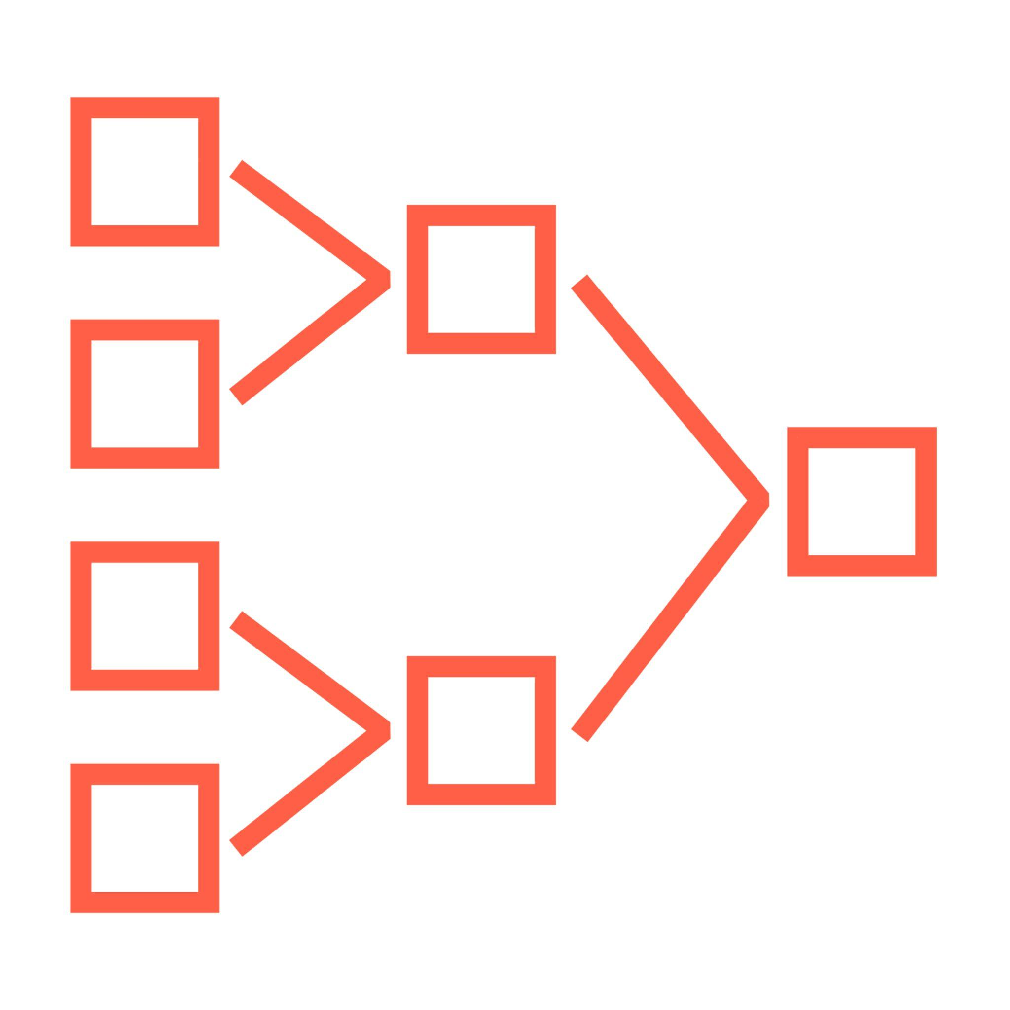


Expectations
DLT
Enforce quality on MVs and STs
Unified
Enforce quality for any UC table
+ unify syntax for:
DLT Expectations
PK/ FK constraints
Lakehouse Monitoring metrics (e.g. count, percent_null)
Notes:
You may be wondering how this differs from DLT Expectations. DLT has always allowed you to use expectations for data quality on MVs and STs, now we’re bringing this capability to any table in Unity Catalog and aligning the syntax so that it’s one streamlined experience to enforce quality. In addition to row-level constraints, you can use LHM to enforce aggregate constraints on data at rest (e.g. count or percent_null which require the whole table to be written.)

Slide 20
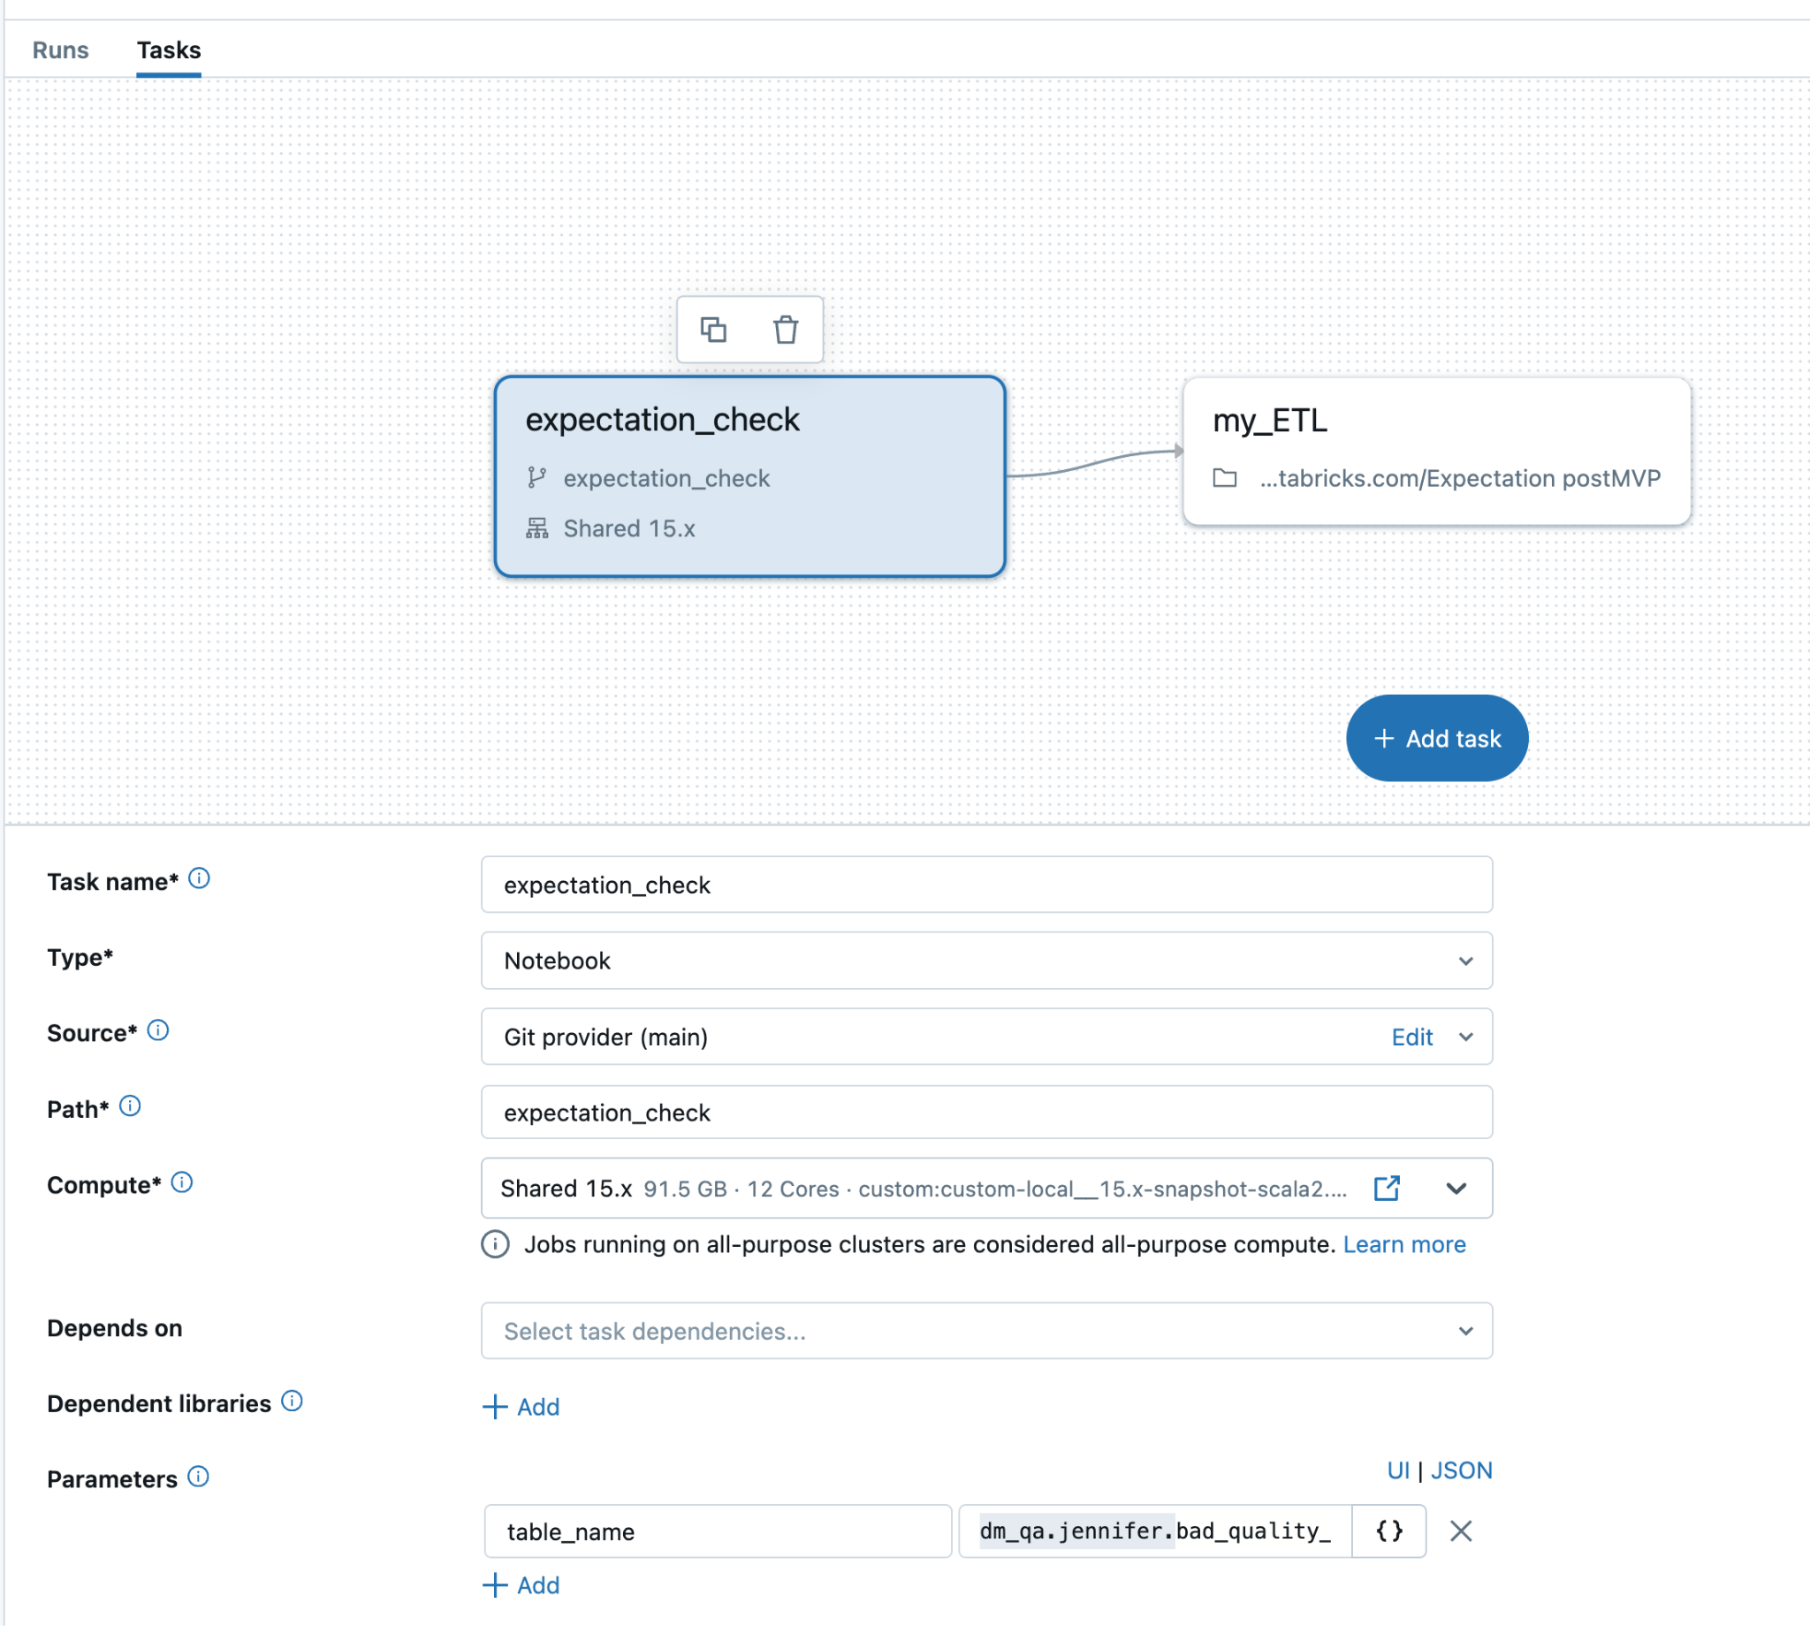
Expectations
In Private Preview
Prevent data quality issues from trickling downstream
ALTER TABLE main.schema.user
ADD CONSTRAINT PRIMARY KEY (user_id)
ADD CONSTRAINT METRICS percent_null(col=>”product_name”) < 0.05
Enforce data quality checks directly in workflows
🔔 Get alerted
⛔ Fail a job
❌ Drop a record
Notes:
Detect common issues like duplicates, incompleteness, or drift before they trickle downstream
Enforce data quality checks directly in workflows
Get alerted, Fail a job or Drop a record upon violation

Slide 21
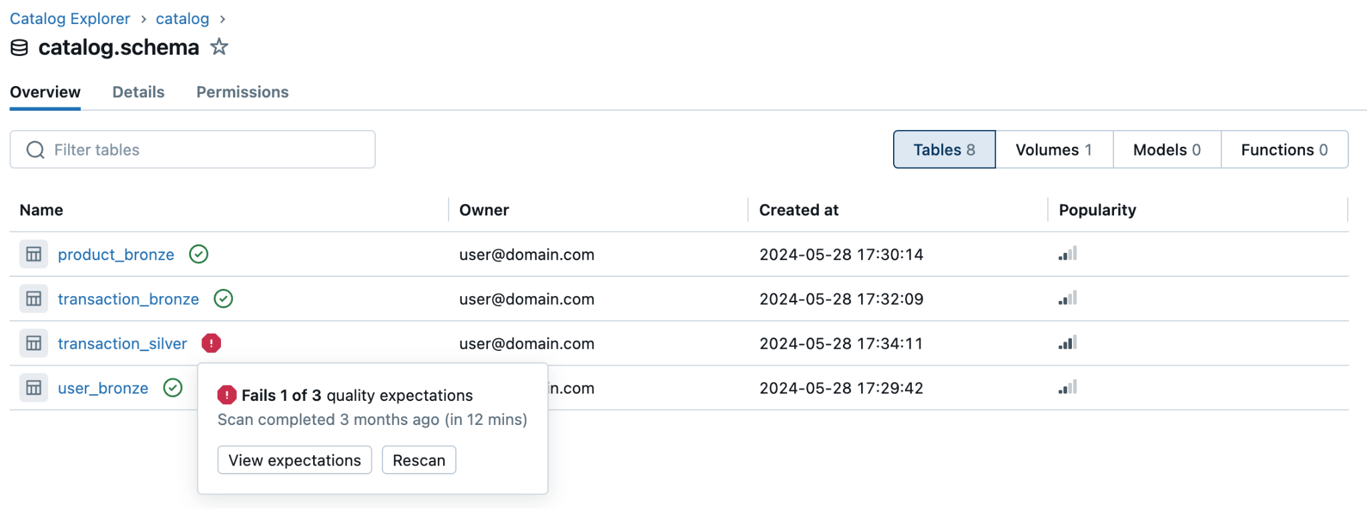
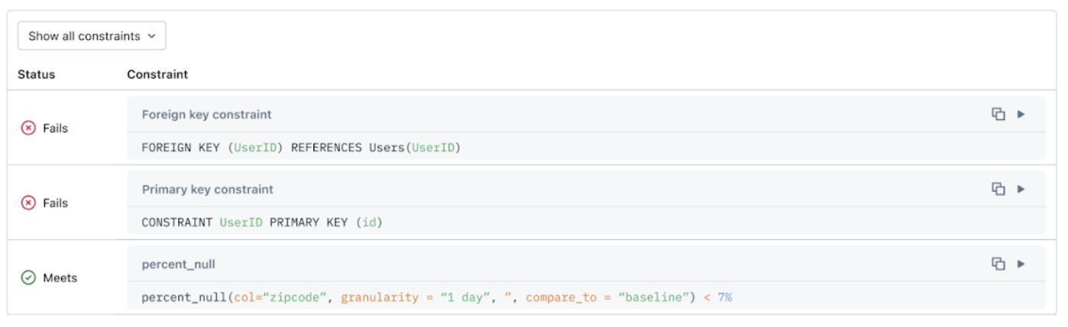
Health Indicator
Coming soon
Understand the health of your tables at a glance
One-click query to debug violating records
Health indicator for every table
Notes:
Lakehouse Monitoring allows you to tie expectations directly in your pipelines to prevent the silent decay of quality. By integrating quality checks directly into your workflows, you can get alerted or fail a job if any table violates your quality rules. Detect common problems like duplicates, incompleteness, and distributional change in your data before they trickle downstream. In the future, Lakehouse Monitoring plans to intelligently set quality thresholds based on data profiling and forecasting. We are excited for what’s to come and encourage you to join our Public Preview for the feature here.

Slide 22
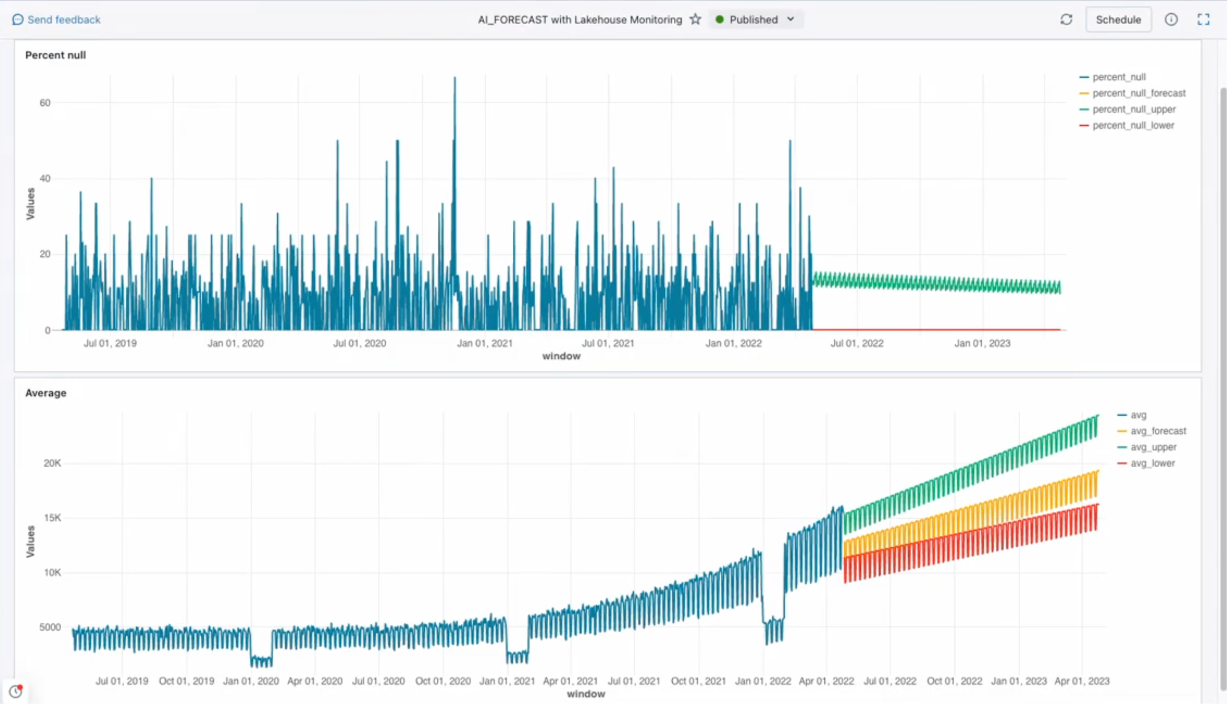
Intelligent Forecasting
Coming soon
Write Expectations with AI suggested thresholds
Set thresholds with confidence and reduce noisy alerts

Slide 23
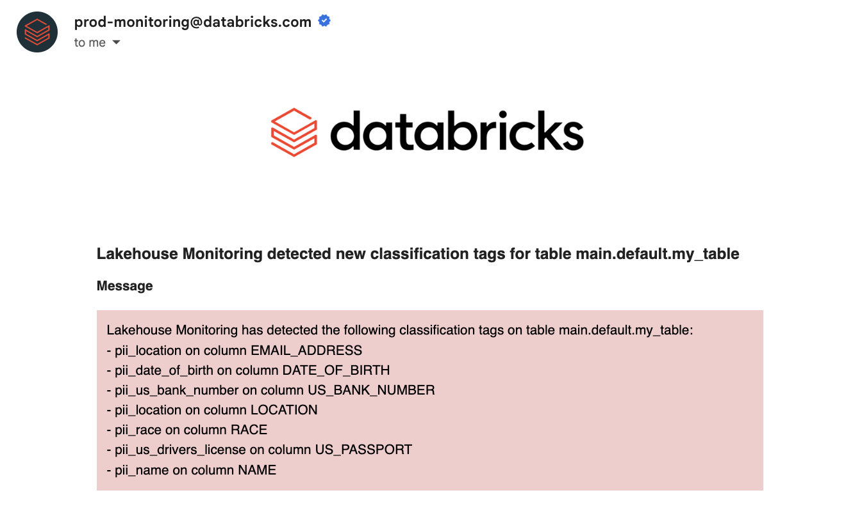
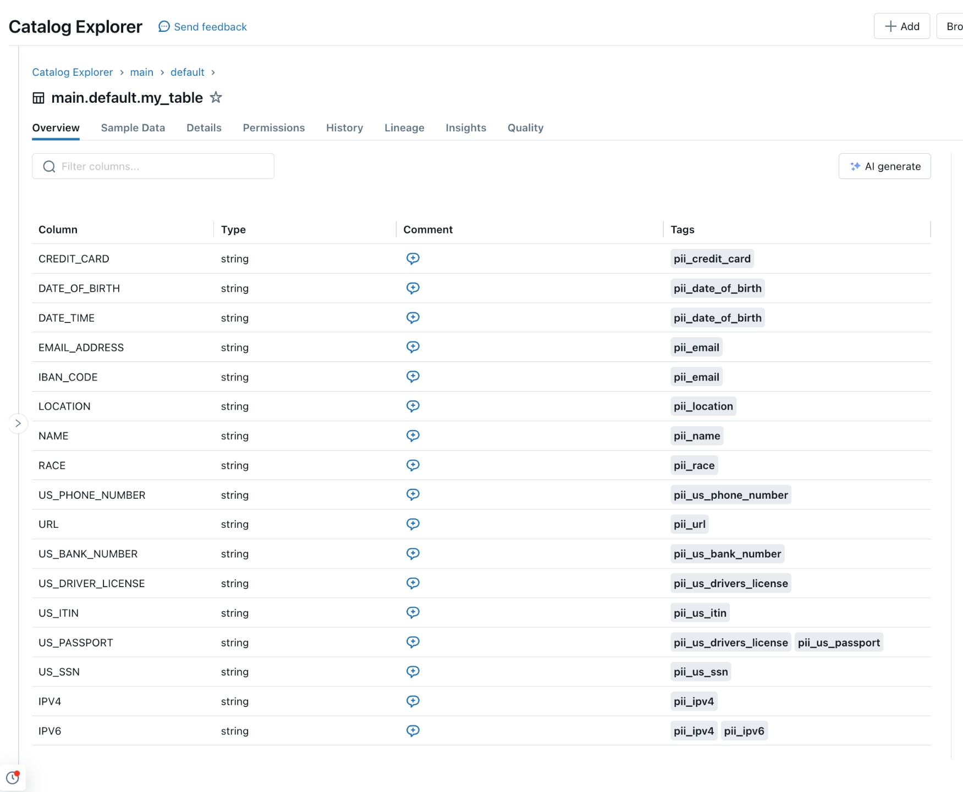
Data Classification
In Private Preview
Automatically scan tables for PII
Built-in classifiers for 16 types of PII
Get alerted when new PII is caught in a column
Support for custom rules and ABAC policies to follow

Slide 24


Get started with Lakehouse Monitoring
Data Classification or Expectations Private Preview:
Lakehouse Monitoring DBdemo:
Sign up form here
Get a product tutorial here

Slide 25
Internal only:

Slide 26







Lakehouse Monitoring (1-slider)
GENERALLY AVAILABLE
PRODUCT DESCRIPTION & WHY IT MATTERS
Databricks Lakehouse Monitoring allows you to monitor all your data pipelines – from data to features to ML models – without additional tools and complexity. Built into Unity Catalog, you can track quality alongside governance and get deep insight into the performance of your data and AI assets. Lakehouse Monitoring is fully serverless so you never have to worry about infrastructure or tuning compute configuration.
It’s simple to set up with out of the box profiling, scalable across data and AI, and intelligent aiming to automate expectations and reduce noisy alerts.
CUSTOMER/INDUSTRY REFERENCES
“Simple to set up, easy to customize, helps us stay ahead of quality issues”
“Builds trust in data and creates autonomy”
Pitch deck →
AZURE
June 13, 2024
AWS
June 13, 2024
GCP
Coming soon
TARGET CUSTOMERS
DIY customers who build monitoring solutions themselves
Customers struggling to configure meaningful alerts (e.g. not too noisy) in their current monitoring solution(s).
Customers who want to standardize quality tooling across data and AI teams
Customers who join model predictions with business data (e.g., clicks on campaigns).
TARGET PERSONAS
CDOs / CTOs
Data Engineers
ML engineers
Data Scientists
PRICING
DBUs will be consumed by the monitoring pipeline and charged to the SERVERLESS_JOBS SKU
USE CASES
What does data integrity look like, and how does it change over time?
How are ML model inputs and predictions drifting over time?
Data Classification / PII Detection
Health indicator for each table
Anomaly and Drift detection
Expectations on Data Quality
WHAT WILL CUSTOMERS ASK?
What metrics are available? [here]
Can I set this up across multiple tables? [yes using the API here]
Which profile type should I chose? [here]
FAQs →
COMPETITIVE POSITIONING
This is the only monitoring service available that monitors data and AI assets in one tool. Integrated directly on the data platform, there’s no need for multiple tools and the complexity that comes with them.
Both AWS and GCP offer decentralized data and ML monitoring services. For example AWS monitors data quality; SageMaker monitors models.
AWS SageMaker customers like the integration with real-time inference.
Azure integrates data and ML monitoring into AzureML. However, their data drift monitoring is in a different tool (Purview.)
HOW TO GET STARTED
Identify customers interested in data quality/ monitoring and reach out to PM team (Jacqueline Li, Kasey Uhlenhuth) who can share roadmap
Try out monitoring by heading to the Quality tab of any table you own and create a monitor using the Databricks UI or API.
Visualize your data profile and debug anomalies using the auto-generated Lakeview dashboard
If you have any questions, please post in #lakehouse-monitoring-discuss
Share this blog with your customers
CTA

Slide 27
Pricing
Serverless Compute based, Official pricing page here
Best practices:
To monitor at scale, we recommend using Time Series or Inference with CDF enabled
Total cost is influenced by:
Data size
# of Slicing expressions
# of Custom metrics
To estimate the cost for your customer, please use our cost calculator: go/lhm/cost-estimator

Slide 28
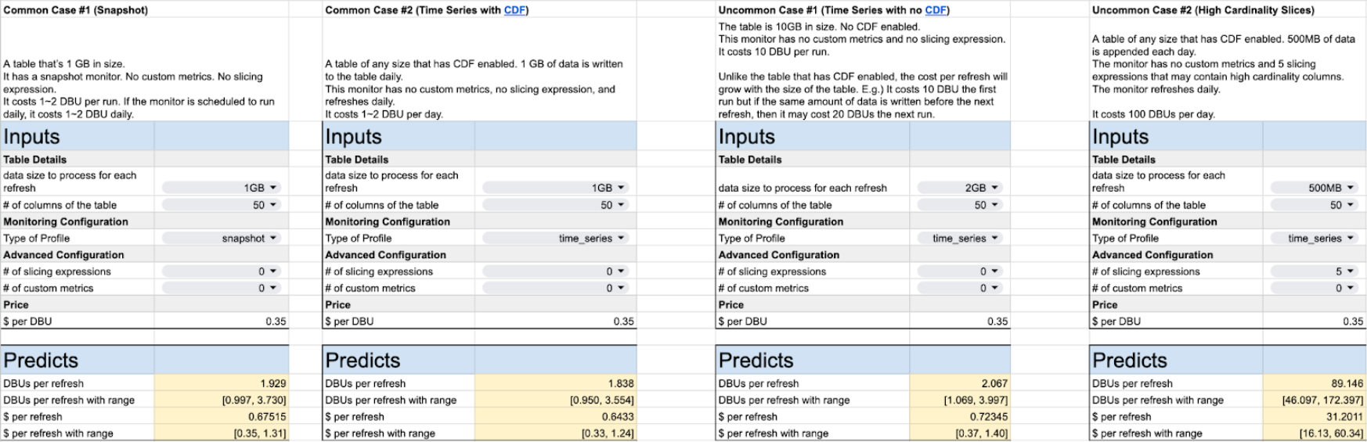
Common cases and their prices
Get a general sense of how much LHM costs with these common cases

Slide 29
Supported Regions
Follows Serverless Jobs
aws-ap-southeast-2
aws-us-east-1
aws-us-west-2
aws-eu-west-1
aws-us-east-2
aws-eu-central-1
azure-eastus2
azure-eastus
azure-westus
azure-westeurope
azure-northeurope
azure-centralus
azure-canadacentral
azure-australiaeast
azure-southeastasia
azure-centralindia
azure-japaneast
azure-brazilsouth
Supported regions are tracked here, if your customer needs a different region please vote on this Aha.

Slide 30
Lakehouse Monitoring Pricing
You pay for the compute you use
Total cost is directly related to the number of rows and columns to be processed.
Incremental processing will be used if Change Data Feed is enabled on the Delta table (strongly recommended) for TimeSeries and InferenceLog analysis types. The Snapshot analysis type does not use incremental processing–the entire table is processed each refresh.
Lakehouse Monitoring auto-scales compute resources up or down based on table size.
For Lakehouse Monitoring, you only pay to Databricks, eliminating additional costs to cloud vendor.
official pricing page

Slide 31
Supported Regions
Azure
eastus
eastus2
centralus
westus
westeurope
northeurope
canadacentral
australiaeast
AWS
us-east-1
us-east-2
us-west-2
eu-west-1
eu-central-1
ap-southeast-2
See supported regions here (should follow Serverless Jobs). If your customer needs a different region please vote on this Aha.

Slide 32
Lakehouse Monitoring Pricing
TODO
go/lhm/cost-estimator
Basic Cost Calculation
Scenario | How much you pay?
No traffic with autoscale to zero | Zero :)
If traffic increases to 20 concurrent requests | (Assuming traffic remains at 20 for next hour. You pay in ms. ) 20 * 1 DBU/hr * price/DB
If traffic increases to 26 concurrent requests | We'd instantly scale provisioned concurrency to 28 (Concurrency scales by 4) 28 * 1 DBU/hr * price/DBU
If traffic decreases to 8 | We’d gradually reduce provisioned concurrency to 8 (nit: we drop concurrency by 4 after 5 mins) 8 * 1 DBU/hr * price/DBU

Slide 33
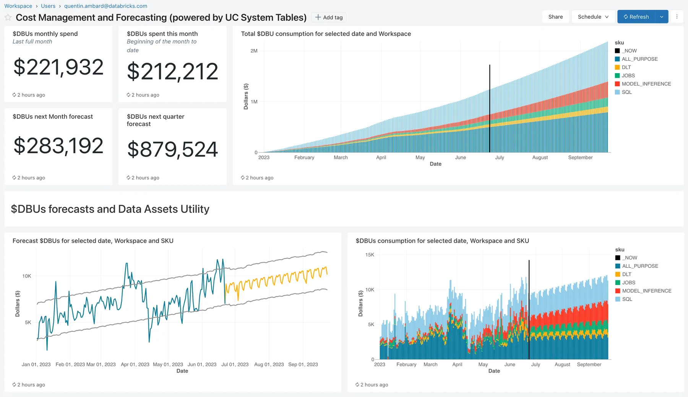
Cost Observability
Monitor usage with system tables and endpoints tags
Leverage Lakehouse existing tools and AI capabilities to continuously monitor and optimize your costs.
System Tables: Monitor consumption and forecast future usage, Trigger alerts when billing goes above your criterias
Endpoint tags: Monitor cost and accurately attribute usage to your organization’s business units and teams
TODO

Slide 34
Cost Estimation
Use cost calculator and Load testing to estimate monthly cost
Example
Use the cost calculator to quickly estimate your monthly expenses.
Conduct a load test with DB provided notebook to validate cost estimates.
Collaborate with Databricks Field Engineering team to learn best practices and to optimize costs efficiently.
Cost Calculator
Average QPS: 200
Peak QPS: 500
Model Execution Latency (sec): 0.1
Uptime (min/day): 1440
Scale-to-zero: No
Latency sensitive: Yes
Recommended Workload Size: L
Expected Cost (per month): $1008.00
Min Cost (per month): $806.40
Max Cost (per month): $3225.60
TODO
“Expected cost” is what a customer would pay with a constant QPS throughput–where they land in the min/max range depends on autoscaling.

